Slide 1
CS305
System Modeling and Simulation
Prof. Dr. Khaled Mahar
khmahar@aast.edu
Lecture 1

Slide 2
Course Code: CS305 Course Title: System Modeling &Simulation
Course Description
The course gives the theoretic aspects of simulation, followed by its probabilistic and statistical underpinnings, including random number generation. It addresses simulation-related theory of input analysis, and output analysis. It also provides a background about Markov chain processes and queuing theory. Finally, the course describes and illustrates modeling of some applications using Arena models.

Slide 3
Modeling and Simulation
Course Objectives
Understand the power and limitations of discrete event simulation.
Plan for and design a simulation experiment for some problems.
Apply standard statistical techniques in analyzing input/output data for a simulation experiment.
Learn how to use Markov Chains for modelling stochastic processes.
Understand the Queuing theory and its applications.

Slide 4
Modeling and Simulation
Text Book
Banks, Carson, Nelson and Nicol , Discrete-Event System Simulation, 5th Edition, Prentice Hall, 2009
Reference Book
Law, Simulation Modeling and analysis, McGraw-Hill, 2007.
Tayfur Altiok, and Benjamin Melamed, Simulation Modeling and Analysis with Arena, Elsevier, 2007.

Slide 5
Course Assessment
7th Week 30 (at least 2 quizzes)
12th Week 20 (quiz and project)
Assignments 10
Final Exam 40

Slide 6
Goals of Course
To understand the basics of computer simulation, including:
Simulation concepts and terminology
When it is useful
Why it is useful
How to develop / run a simulation
How to interpret / analyze the results

Slide 7
Goals of Course
To understand and utilize some of the mathematics required in simulations
Statistical models and probability distributions
How various models are defined
Which models are correct for which situations.
Random number theory
Generating and testing pseudo-random numbers
Generating pseudo-random values within various distributions

Slide 8
Goals of Course
To understand and utilize some of the mathematics required in simulations (cont.)
Analysis of input data
Is the data and its statistical distribution appropriate for the simulation?
Analysis of output data
How confident are we in our results?
Simple queuing theory
Characteristics
Performance measures
Markovian models

Slide 9
Goals of Course
To implement some simulation projects
Any programming language can be used.
There are special-purpose simulation languages and packages.

Slide 10
Introduction to Simulation
What is simulation?
A simulation is the imitation of the operation of a real-world process or system over time.
It involves the generation of an artificial history of a system, and the observation of that artificial history draws inferences .
Notes:
In a simulation we use a computer to evaluate a model (of a system) numerically, and data are gathered in order to estimate the desired true characteristics of the model"

Slide 11
Introduction to Simulation
Why (or when) do we use simulation?
Experiments on real systems are too expensive, too dangerous, or the system to be investigated does not yet exist.
The time scale of the dynamics of the system is not compatible with that of the experimenter
Easy manipulation of parameters of models (even outside the feasible range of a particular physical system)
Suppression of disturbances
Notes:
e.g. Investigating ship durability by building ships and letting them collide is a very expensive method of gaining information; training nuclear plant operators in handling dangerous situations by letting the nuclear reactor enter hazardous states is not advisable.
e.g. It takes millions of years to observe small changes in the development of the universe, whereas similar changes can be quickly observed in a computer simulation of the universe.
e.g. The mass of a body in a computer-based simulation model can be increased from 40 to 500 kg at a keystroke, whereas this change might be hard to realize in the physical system.
e.g. simulation of free-fall objects ignores the effect of air resistance

Slide 12
Introduction to Simulation
Why (or when) do we use simulation?
Consider arbitrary large system X
Could be a computer system, a highway, a factory, a space shuttle, etc.
We'd like to evaluate X under different conditions
Option 1: Build system X and generate the conditions, then examine the results
Option 2: Model system X, simulate the conditions and use the simulation results to decide
Notes:
For option 1, This is not always feasible for many reasons:
X may be difficult to build
X may be expensive to build
We may not want to build X unless it is "worthwhile"
The conditions that we are testing may be difficult or expensive to generate for the real system

Slide 13
Introduction to Simulation
Why (or when) do we use simulation?
Example 1. A company needs to increase its production and needs to decide whether it should build a new plant or it should try to increase production in the plants it already has.
Which option is more cost-effective for the company?
Example 2. NASA wants to know if damage on the Space Shuttle will threaten it upon re-entry.
If they wait until re-entry to make a judgment, it is already too late
Notes:
Clearly, building the new plant would be very expensive and would not be desirable to do unless it is the more cost-effective solution
But how can we know this unless we have built the new plant?

Slide 14
Introduction to Simulation
Why (or when) do we use simulation?
Continuing with the Production example:
Model both possibilities for increasing production and simulate them both
We then choose the solution that is most economically feasible
Continuing with the Space Shuttle example|:
Model the damage and the stress that re-entry imparts on the shuttle
Determine via a simulation if the damage will threaten the shuttle or not
Note the importance of being correct here
Notes:
Clearly, this is itself not a trivial task
Simulations are often large, complex and difficult to develop
Just developing the correct system model can be a daunting task
There are many variables that must be taken into account
However, if a new plant costs hundreds of millions or even billions of dollars, spending on the order of thousands (or even hundreds of thousands) of dollars on a simulation could be a bargain
Note that with the Shuttle example, most of the work for this must be done in advance
Don't have time to design & implement this during the duration of a flight

Slide 15
Introduction to Simulation
When is Simulation not Appropriate?
Don't use a simulation when the problem can be solved in a "simpler" or more exact way.
Example: Given N rolls of a fair pair of dice, what are the relative expected frequencies of each of the possible values {2, 3, 4, … 12} ?
We could certainly simulate this, "rolling" the dice N times and counting
However, based on the probability of each possible result, we can derive a more exact answer analytically
Notes:
Total of 36 possible outcomes
For N "rolls", the expected frequency of value i is N * (P_{i}) = N * (outcomes yielding i / total outcomes)
For example, for 900 rolls, the expected number of 9s generated would be 900 * (4 / 36) = 100
Note that the expected value may not be a whole number (nor should it necessarily be)
Given 500 rolls, the expected number of 9s is 500 * (4 / 36) ≈ 55.55

Slide 16
Introduction to Simulation
When is Simulation not Appropriate?
Don't use a simulation if it is easier or cheaper to experiment directly on a real system
Example: A 24 hour supermarket manager wants to know how to best handle the cash register during the "midnight shift":
Have one cashier at all times
Have two cashiers at all times
Have one cashier at all times, and a second cashier available (but only working as cashier if the line gets too long).
Notes:
Each of these can be done during operating hours
An extra employee can be used to keep track of queue data (and would not be too expensive)
Differences are (likely) not that drastic so that customers will be alienated

Slide 17
Introduction to Simulation
When is Simulation not Appropriate?
Don't use a simulation if the system is too complex to model correctly / accurately
A bad model may not be helpful and could actually be harmful.
Example: With the Space Shuttle, lives were at risk – if the model predicts incorrectly the results are catastrophic

Slide 18
Introduction to Simulation
Advantages of Simulation
Effects of variations in the system parameters can be observed without disturbing the real system.
New system designs can be tested without committing resources for their acquisition
Time can be expanded or compressed to allow for speed up or slow down of the phenomenon under investigation.
Insights can be obtained about the interactions of variables and their importance

Slide 19
Introduction to Simulation
Disadvantages of Simulation
Model building requires special training.
Simulation results are often difficult to interpret.
Most simulation outputs are random variables - based on random inputs – so it can be hard to distinguish whether an observation is the result of system inter-relationship or randomness
Simulation modeling and analysis can be time consuming and expensive.
Notes:
Offsetting the Disadvantages of Simulation
Utilize simulation packages that only need input for their operation, e.g.: SIMULINK, MS-Excel
Many simulation packages have output analysis capabilities, e.g. MATLAB, Excel
Simulation has become faster due to advances in hardware

Slide 20
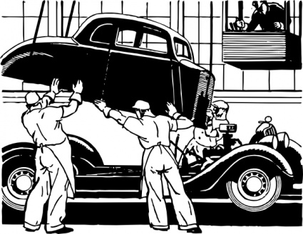
Some Definitions
System
"A group of objects that are joined together in some regular interaction or interdependence toward the accomplishment of some purpose“
Example: A production system manufacturing automobiles. Machines, components and workers operate jointly to produce vehicles.

Slide 21
System Components
Object of interest in the system
Entity
Attribute
State
Activity
Event
An instantaneous occurrence that may change the state of the system
Property of an entity
System
An action that takes place over a period of specified length and changes the state of the system
The collection of variables necessary to describe the system at a particular time, relative to the objectives of the study
Notes:
Entities
Objects of interest within a system
Typically "active" in some way
Ex: Customers, Employees, Devices, Machines, etc
Entity contain attributes to store information about it
Ex: For Customer: items purchased, total bill
Entity May perform activities while in the system
Ex: For Customer: shopping, paying bill
Events Instantaneous occurrences that may change the state of a system
Ex: A customer arrives at a store

Slide 22
System Components
Exogenous:
Activities and events occurring outside the system
Endogenous:
Activities and events occurring within a system
Notes:
Endogenous event
Events occurring within the system
Ex: Customer moves from shopping to the check-out
Exogenous event
Events relating / connecting the system to the outside
Ex: Customer enters or leaves the store

Slide 23
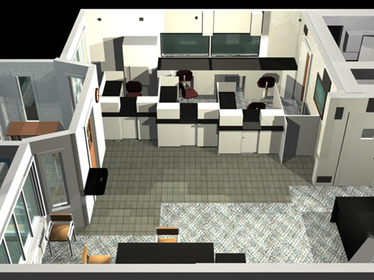











Example
Attribute:
Balance in the customers’ accounts
State Variables:
# busy tellers,
# customers waiting in line or being served
Entity: Customers
Activity:
Making deposits
Events:
Arrival, departure

Slide 24
Examples
System | Entities | Attributes | Activities | Events | State Variables
Railway | Passengers | Origin, destination | Traveling | Arrival at station, arrival at destination | Number of passengers waiting at each station
Production | Machines | Speed, capacity, breakdown rate | Welding, stamping | Breakdown | Status of machines (busy, idle, shutdown)
Communications | Messages | Length, destination | Transmitting | Arrival at destination | Number of packets waiting to be transmitted
Inventory | Warehouse | Capacity | Withdrawal | Demand | Level of inventory

Slide 25
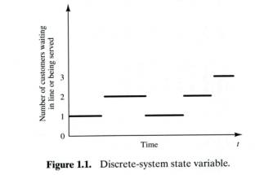
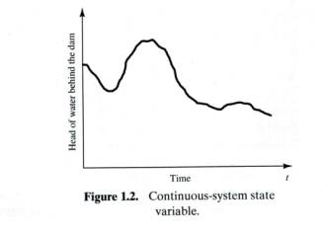
Types of Systems
Discrete
Continuous
State variables change continuously over time
Example: Airplane flight
Position and velocity are constantly changing with respect to time
State variables change instantaneously at separated points in time
Example: Bank
Number of customers changes only when customer arrives or departs
Notes:
Discrete System
Ex: Number of students in a course
When a registration or add is completed, number of students increases, and when a drop is completed, number of students decreases
Continuous System
Ex: Volume of CO₂ in the atmosphere
CO₂ is being generated via people (breathing), industries and natural events and is being consumed by plants

Slide 26
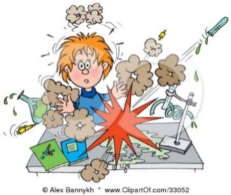
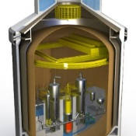
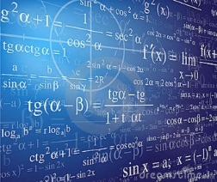
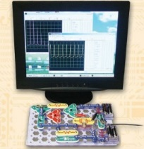
Ways to Study a System
System
Experiment with the Actual System
Experiment with a Model of the System
Physical Model
Mathematical Model
Analytical Solution
Simulation
Notes:
A physical representation of the system (often scaled down) that is actually constructed
Mathematical relationships
Simple ex: d = v_{o}t + ½ at²
This equation can be used to predict the distance traveled by an object at time t
If the model is not too complex we can sometimes solve it in a closed form using analytical methods

Slide 27
System Models
A model is a simplified representation of a system for the purpose of studying that system
It is only necessary to consider those aspects of the system that affect the problem under investigation
Notes:
Allows us to study a system without actually building it (which, as we discussed previously, could be very expensive and time-consuming to do)

Slide 28
Classifications of Simulation Models
Static
Dynamic
Deterministic
Stochastic
Discrete
Continuous

Slide 29
Static and Dynamic Models
Static
Models a system at a single point in time, rather than over a period of time
Example: Simulation of a coin toss game
Dynamic
Represents systems as they change over time
Example: The simulation of a bank from 9:00am – 4:00pm
Sometimes called Monte Carlo simulations
Notes:
Mote Carlo :A problem solving technique used to approximate the probability of certain outcomes by running multiple trial runs, called simulations, using random variables.
The Monte Carlo method uses repeated random sampling to generate simulated data to use with a mathematical model. This model often comes from a statistical analysis, such as a designed experiment or a regression analysis.

Slide 30
Deterministic and Stochastic Models
Deterministic
Contain no random variables
Stochastic
Has one or more random variables
Has a known set of inputs that will result in a unique set of outputs
Example: Patients arriving at the dentist’s office exactly at their scheduled appointments
Random inputs lead to random outputs
Random outputs →only estimates of the true characteristics of the system
Example: random arrivals at a bank. Output may be average number of waiting customers, average waiting time. This output is only a statistical estimate of the system

Slide 31
Discrete and Continuous Models
Discrete
Not always used to simulate a discrete system
Continuous
Not always used to simulate a continuous system
Example: Tanks and pipes may be modeled discretely, even though the flow is continuous
The choice of whether to use a discrete or continuous model depends on the characteristics of the system and the objectives of the study

